Slide 1

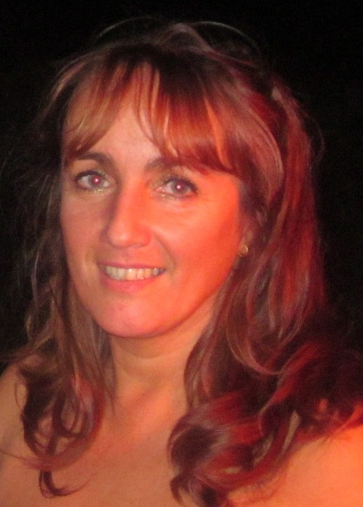

Danceography classes with Vanessa
Walk in…
Mon 6.30pm Fitsteps
7.30pm Ballroom/Latin (Beg)
Les Adams Methodist Hall
Wed 6pm Fitsteps
7pm Rock N Roll/Retro
(Sylvans FC)
Personal Lessons available on request
Dance Out…
07781123486
vanessajames1966@hotmail.com
www.danceographyguernsey.com
IDTA Qualified Dance Teacher & FitSteps
“No matter what size,
shape, age or ability you are…
if “Strictly’s” Lisa Riley can do it,
you can too!”

